Slide 1
Effect of Inhibitory Gamma Rhythm Conductance on Nonlinearity
2/6/2024

Slide 2
GOAL
We have now optimized the inhibitory synapse configuration and timing in our model. We are interested in determining the effect of increasing inhibitory conductance of GABA synapses in the background gamma rhythm on the nonlinearity of the dendrite.

Slide 3
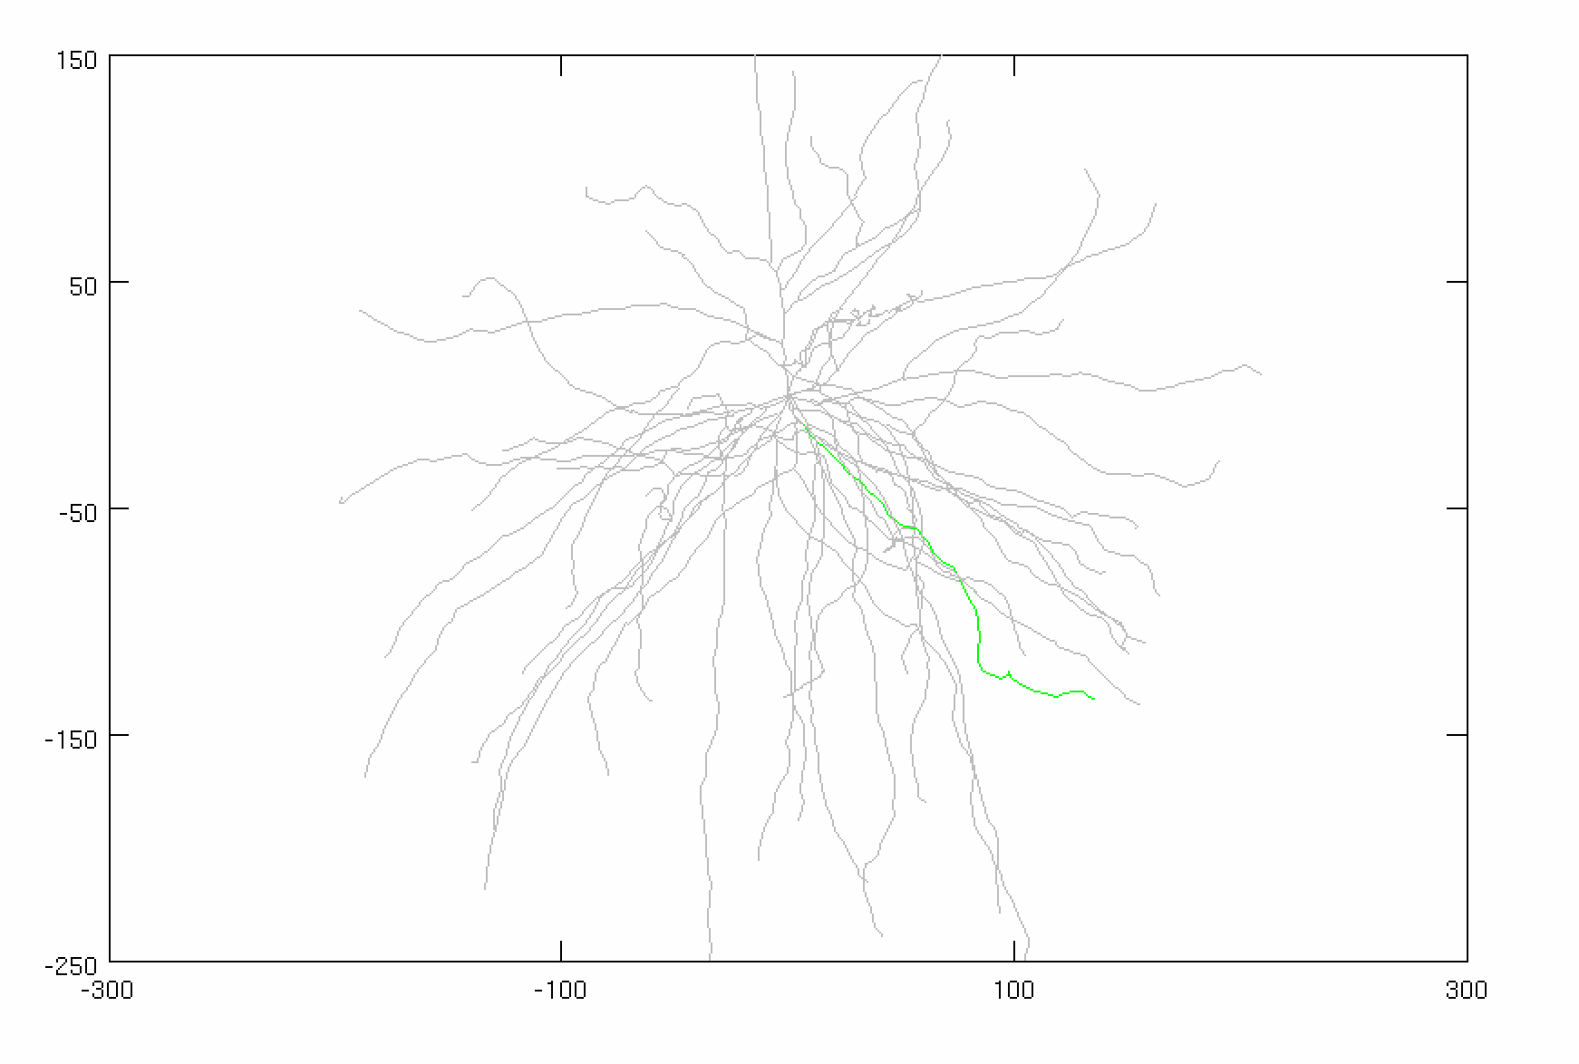
Model Parameters
Inhibitory Gamma
N_syn = 30 (ON SOMA)
Firing rate: 50 Hz
Distribution: 3 ms
Conductance: VARIABLE
Adjusted Current
Amplitude: VARIABLE
Noise: 0 nA
Stimulus
Total synapses: 40 synapses
AMPA: 0.0015 µS
NMDA: 0.0039 µS
Firing rate: 50 Hz
Start Time: 5 ms
Noise: 0 ms
Location: 50% of DEND
(FOCAL, SYNCHED)
AVG: 25 trials
CONSTANT

Slide 4
STEPS
Batch ran an algorithm to determine what current needs to be injected to bring the background firing rate to ~0.5 Hz for each GABA conductance value
Batch ran FI and FS curves in parallel (100 trials x 10 avg per trial, 1000 sample size for each curve)
Generated IS curves and linear-sigmoid fit parameters

Slide 5
CASE #1:
Conductance: 0.000 µS
Steady Current: 1.100 nA

Slide 6
CASE #1:
Conductance: 0.000 µS
Steady Current: 1.100 nA

Slide 7
CASE #2:
Conductance: 0.001 µS
Steady Current: 1.275 nA

Slide 8
CASE #2:
Conductance: 0.001 µS
Steady Current: 1.275 nA

Slide 9
CASE #3:
Conductance: 0.002 µS
Steady Current: 1.425 nA

Slide 10
CASE #3:
Conductance: 0.002 µS
Steady Current: 1.425 nA

Slide 11
CASE #4:
Conductance: 0.003 µS
Steady Current: 1.575 nA

Slide 12
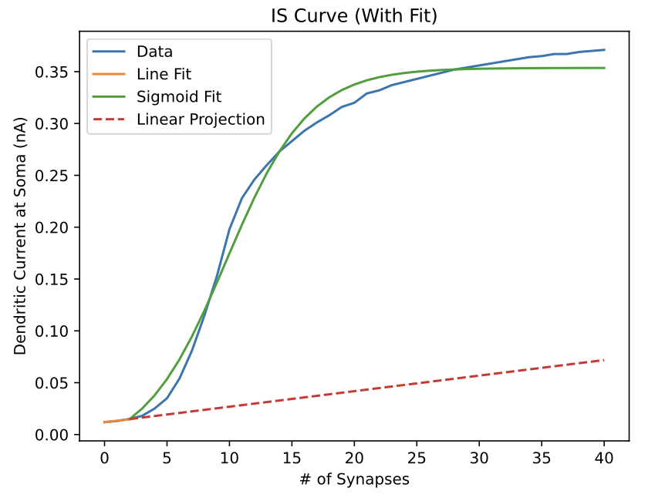
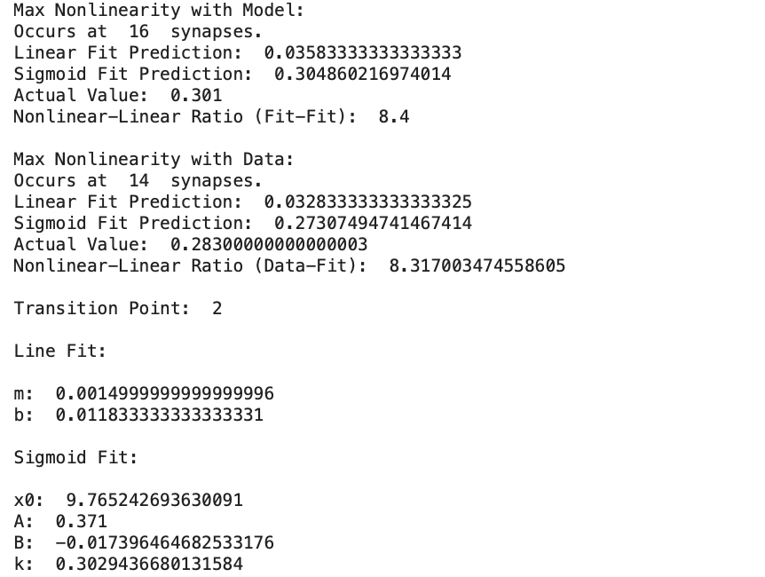
CASE #4:
Conductance: 0.003 µS
Steady Current: 1.575 nA

Slide 13
CASE #5:
Conductance: 0.004 µS
Steady Current: 1.750 nA

Slide 14
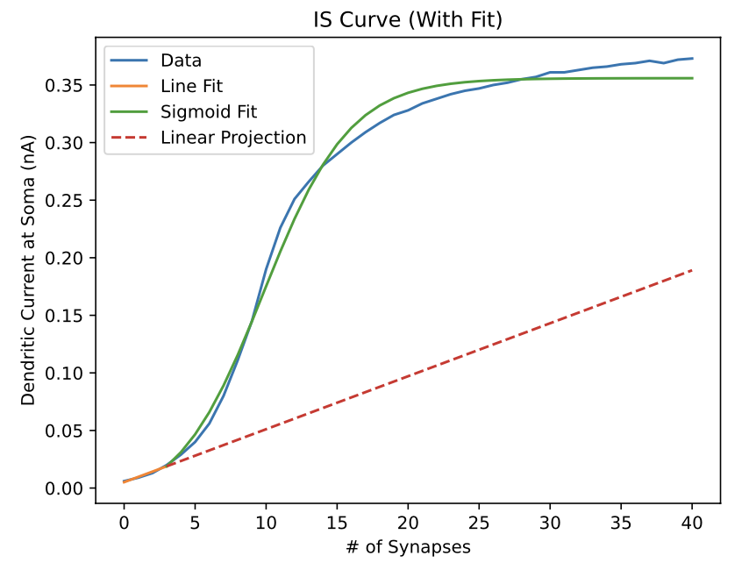
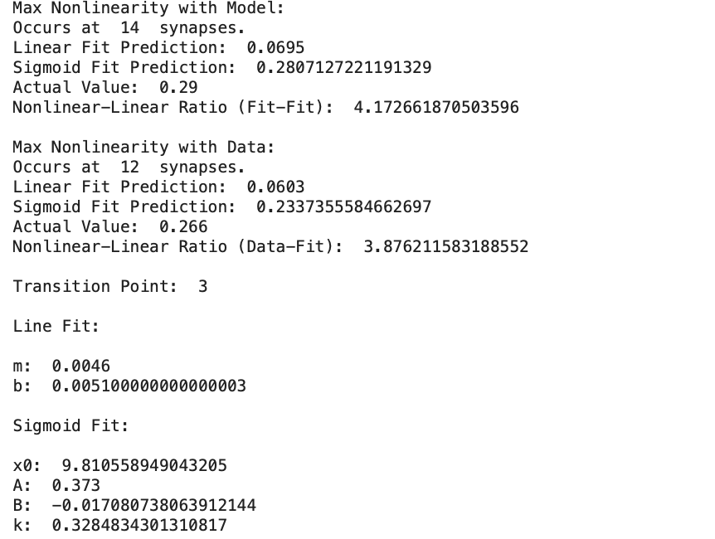
CASE #5:
Conductance: 0.004 µS
Steady Current: 1.750 nA

Slide 15
CASE #6:
Conductance: 0.005 µS
Steady Current: 1.875 nA

Slide 16
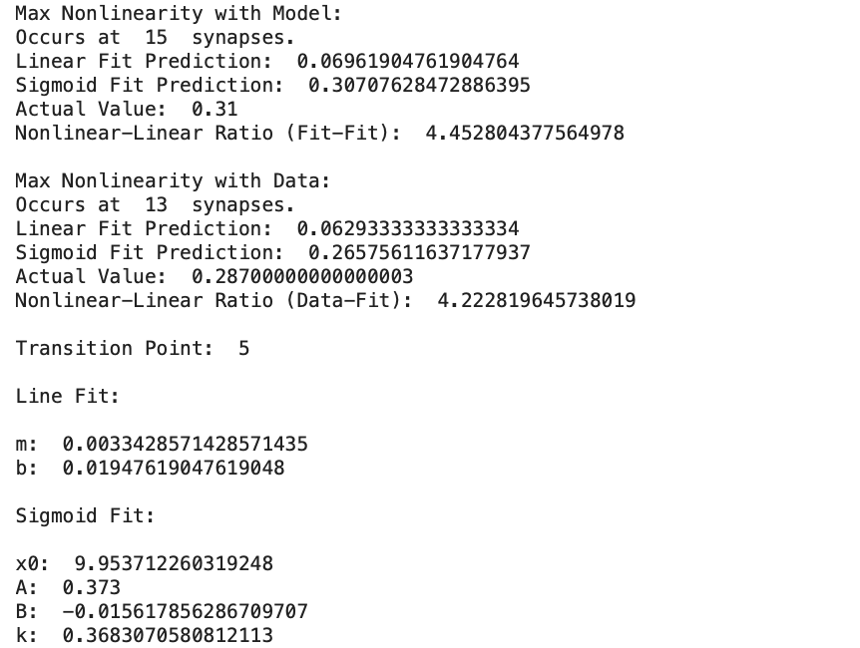
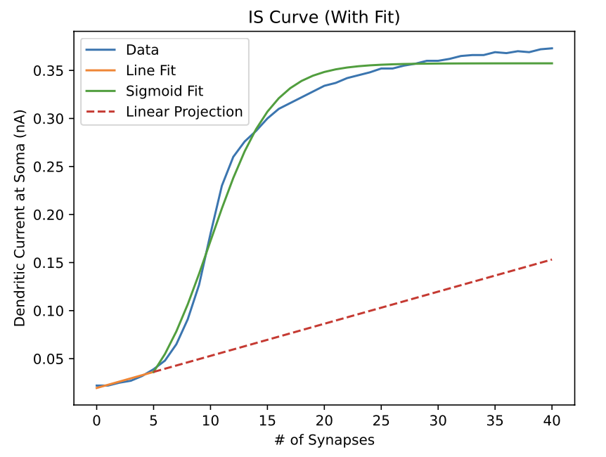
CASE #6:
Conductance: 0.005 µS
Steady Current: 1.875 nA

Slide 17
CASE #7:
Conductance: 0.006 µS
Steady Current: 2.000 nA

Slide 18
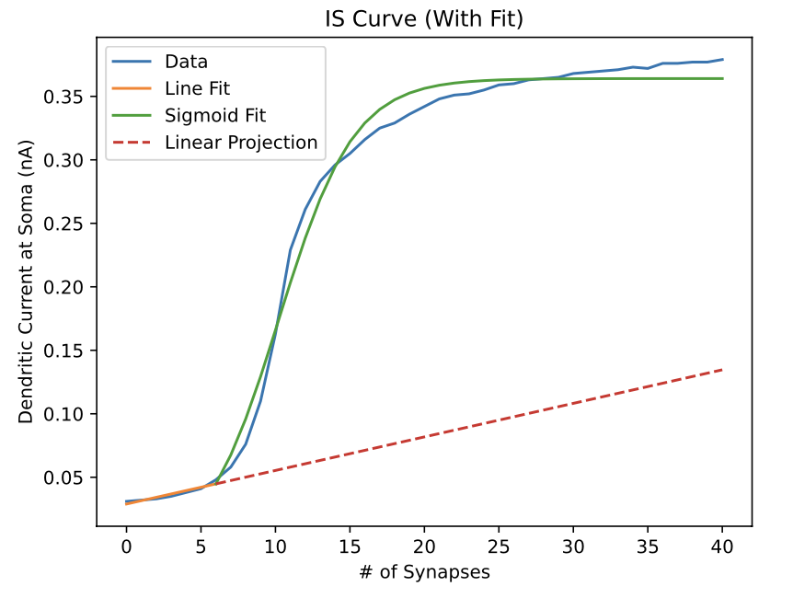
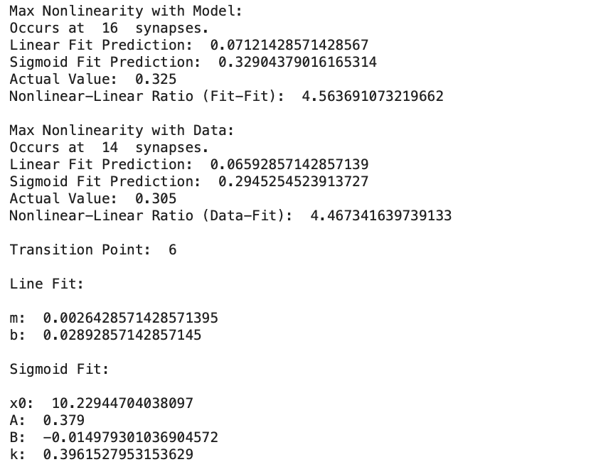
CASE #7:
Conductance: 0.006 µS
Steady Current: 2.000 nA

Slide 19
CASE #8:
Conductance: 0.007 µS
Steady Current: 2.175 nA

Slide 20
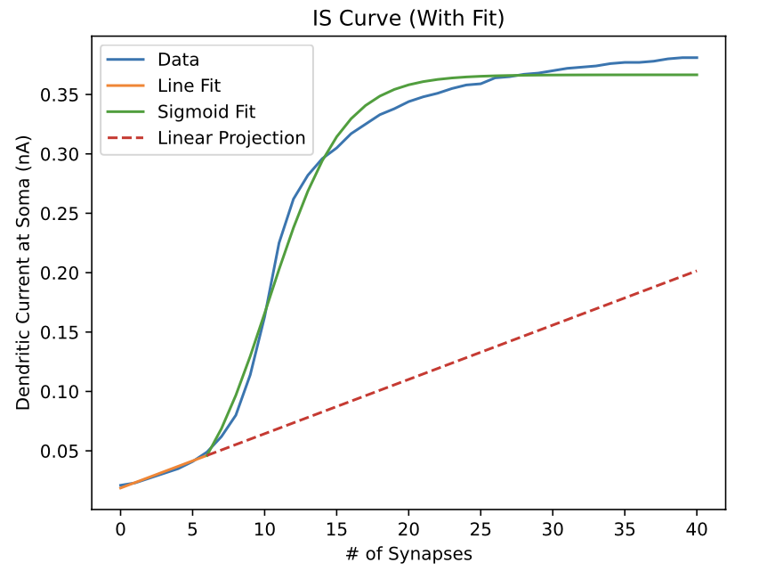

CASE #8:
Conductance: 0.007 µS
Steady Current: 2.175 nA

Slide 21
CASE #9:
Conductance: 0.008 µS
Steady Current: 2.275 nA

Slide 22
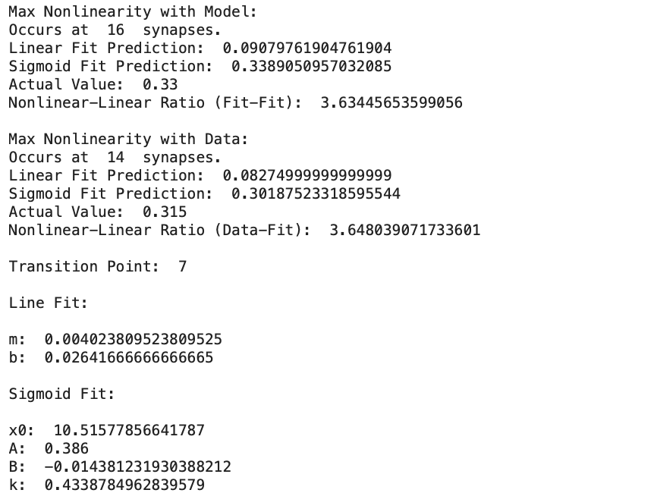
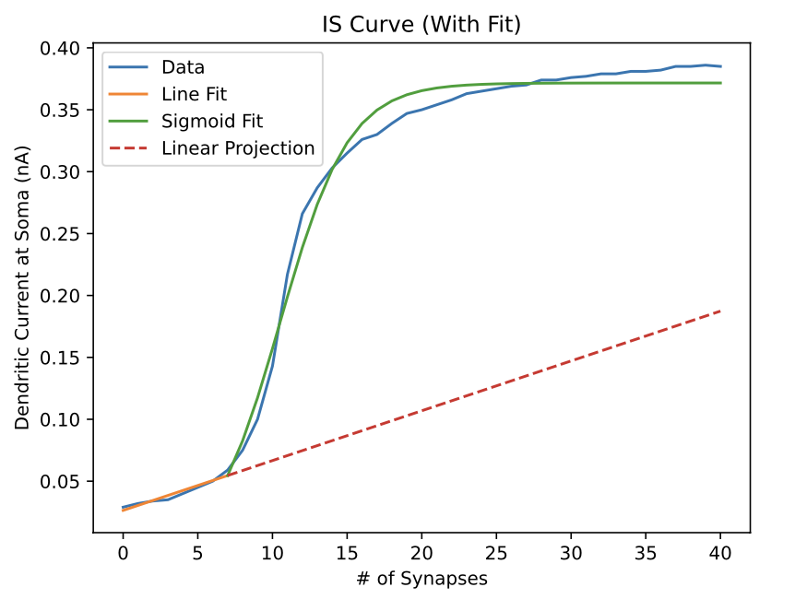
CASE #9:
Conductance: 0.008 µS
Steady Current: 2.275 nA

Slide 23
CASE #10:
Conductance: 0.009 µS
Steady Current: 2.400 nA

Slide 24
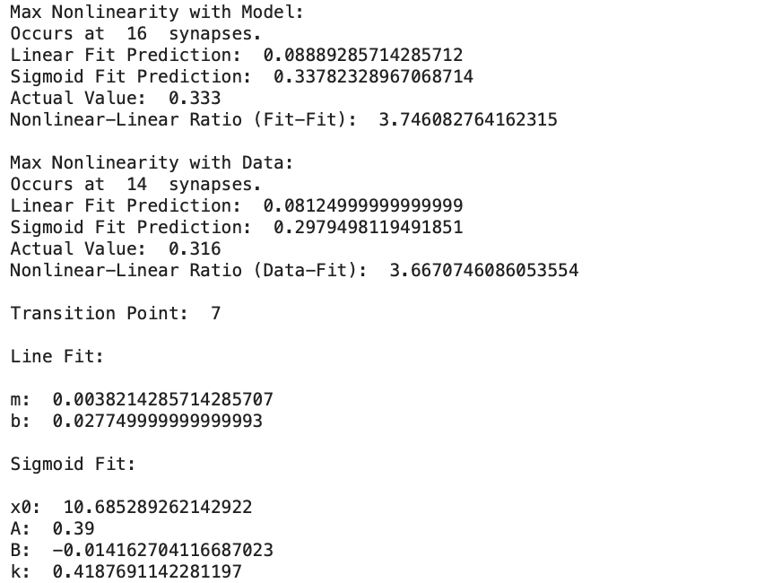
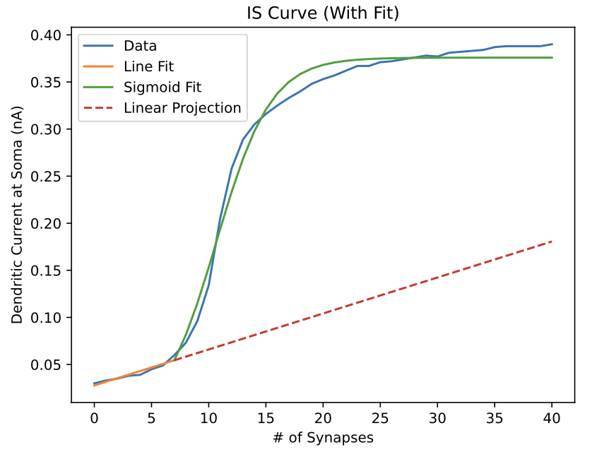
CASE #10:
Conductance: 0.009 µS
Steady Current: 2.400 nA

Slide 25
CASE #11:
Conductance: 0.010 µS
Steady Current: 2.550 nA

Slide 26
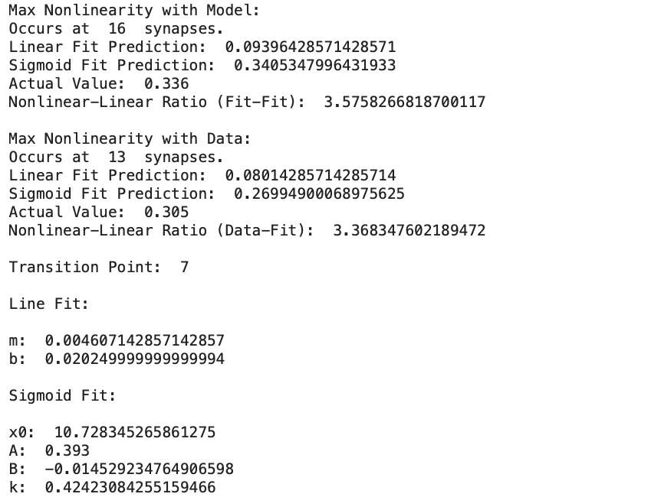
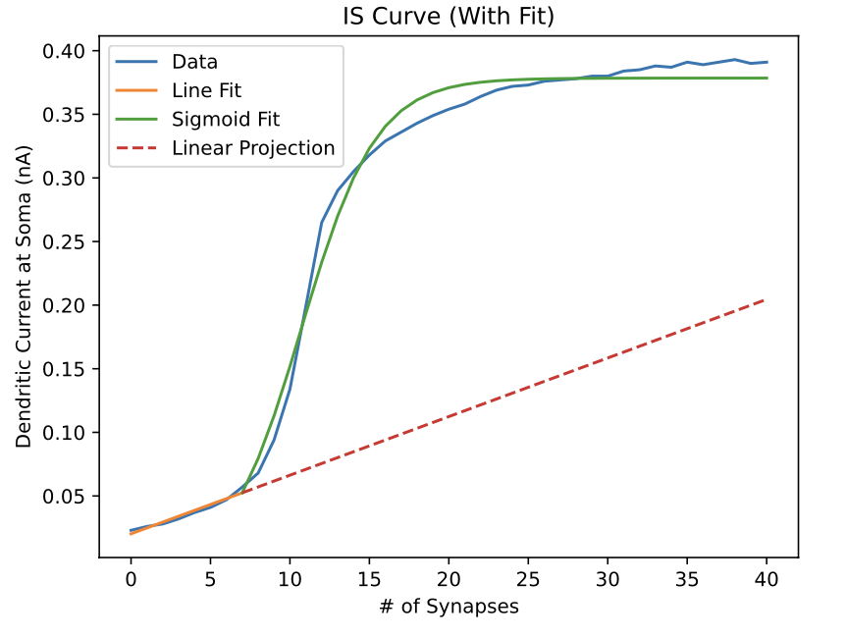
CASE #11:
Conductance: 0.010 µS
Steady Current: 2.550 nA

Slide 27
CASE #12:
Conductance: 0.011 µS
Steady Current: 2.650 nA

Slide 28
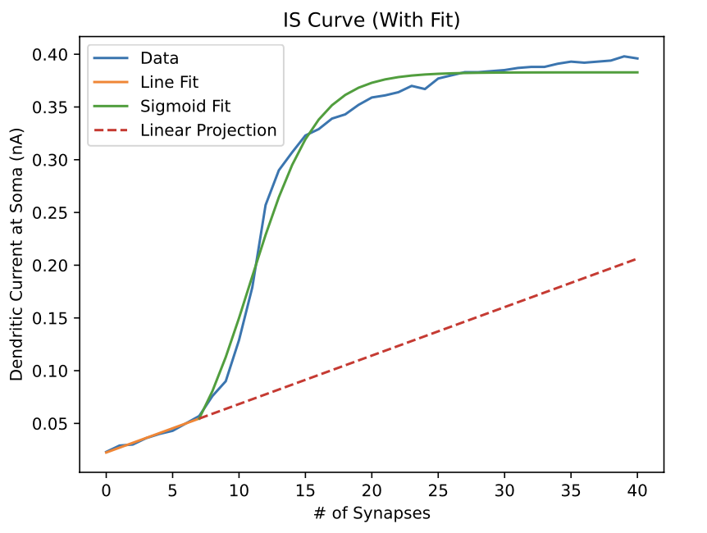

CASE #12:
Conductance: 0.011 µS
Steady Current: 2.650 nA

Slide 29
CASE #13:
Conductance: 0.012 µS
Steady Current: 2.800 nA

Slide 30
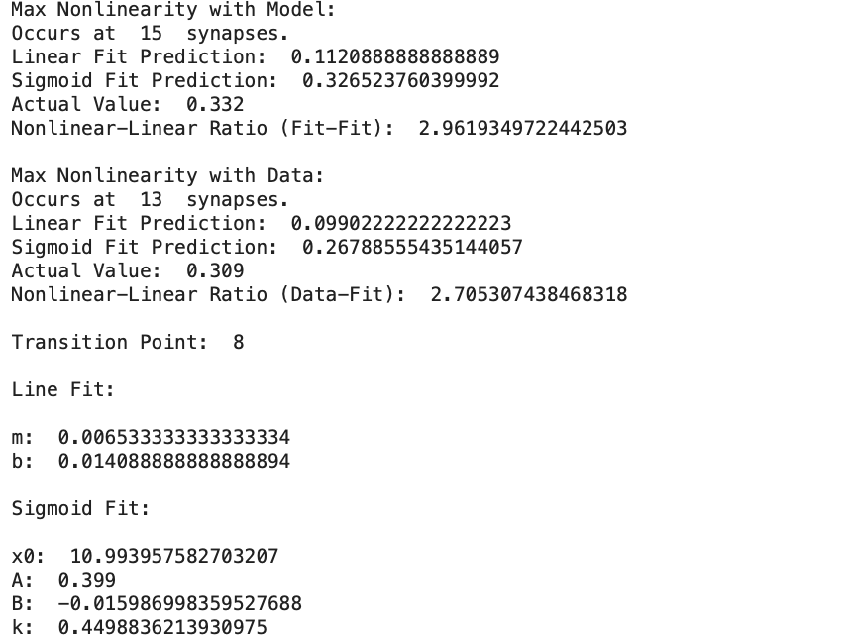
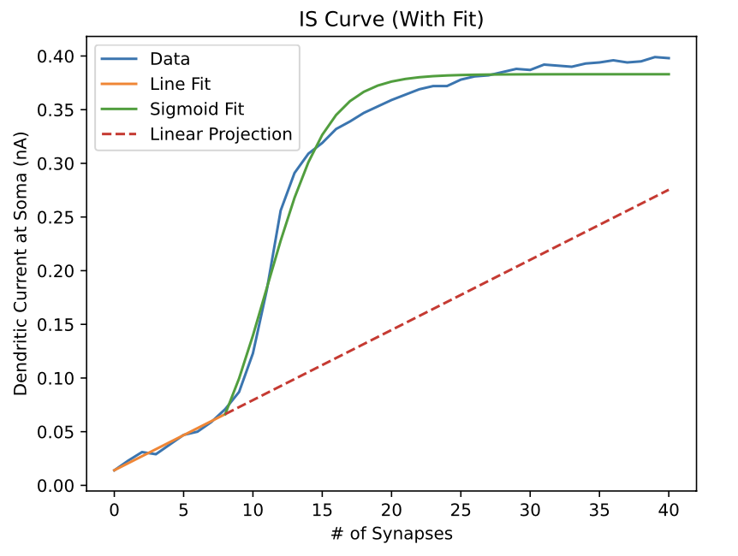
CASE #13:
Conductance: 0.012 µS
Steady Current: 2.800 nA

Slide 31
CASE #14:
Conductance: 0.013 µS
Steady Current: 2.875 nA

Slide 32
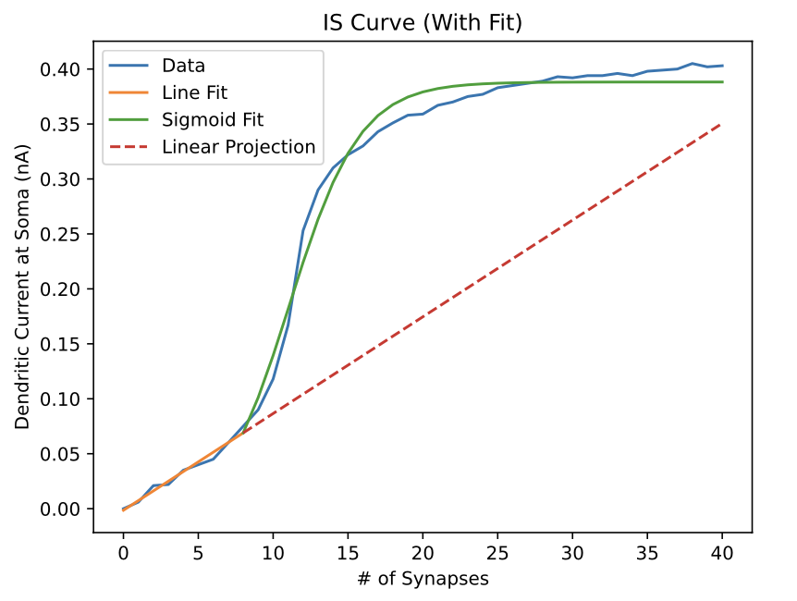
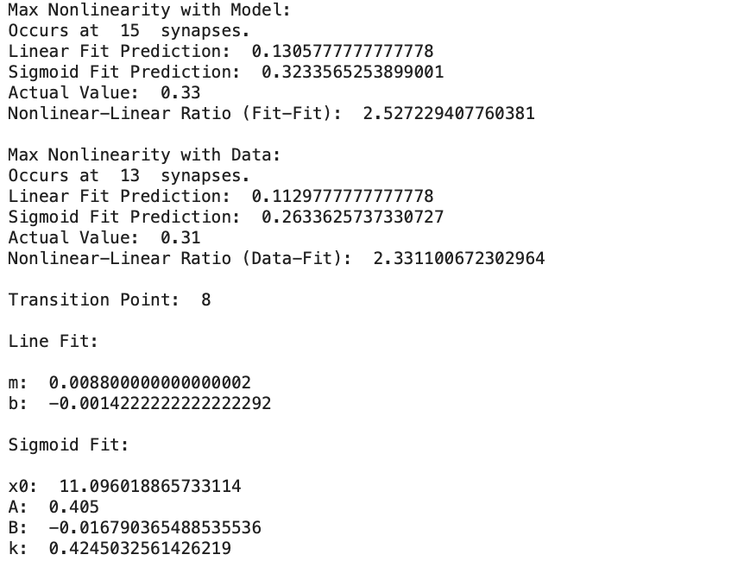
CASE #14:
Conductance: 0.013 µS
Steady Current: 2.875 nA

Slide 33
CASE #15:
Conductance: 0.014 µS
Steady Current: 3.000 nA

Slide 34
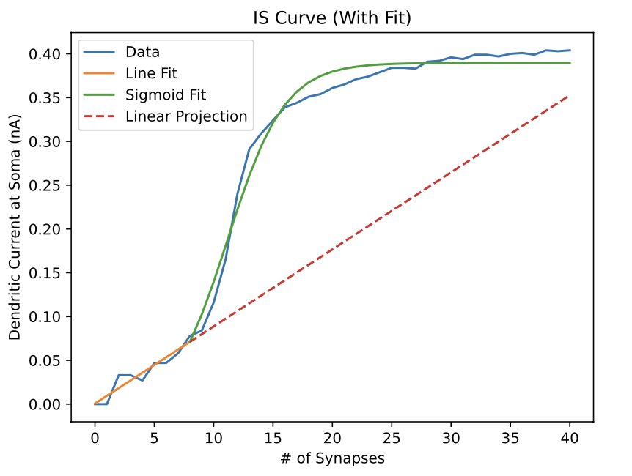
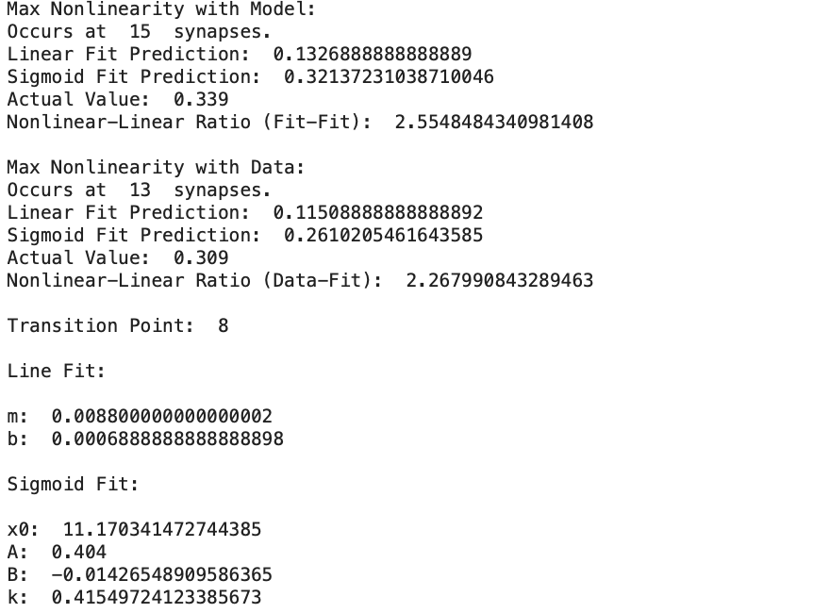
CASE #15:
Conductance: 0.014 µS
Steady Current: 3.000 nA

Slide 35
CASE #16:
Conductance: 0.015 µS
Steady Current: 3.125 nA

Slide 36
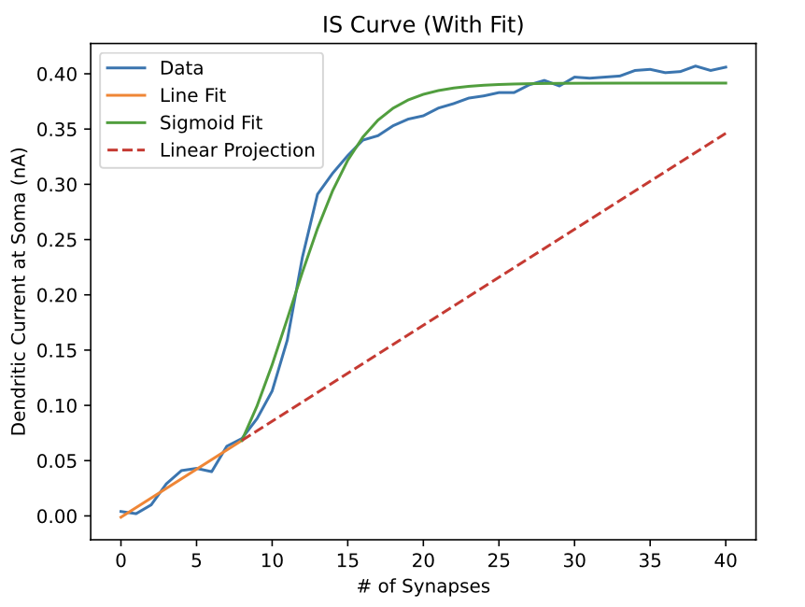
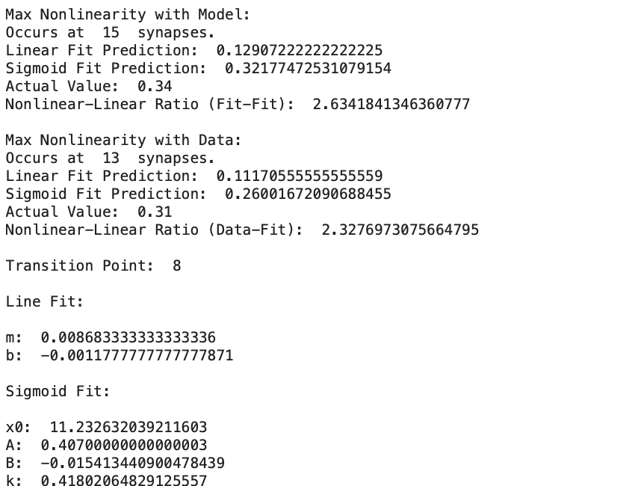
CASE #16:
Conductance: 0.015 µS
Steady Current: 3.125 nA

Slide 37
CASE ANALYSIS

